Slide 1
Spatial Neural Network
BY Christopher Iuel

Slide 2
Index
Introduction
Content
Manual
Theory
Discussion
Future changes
Conclusion
Dependencies

Slide 3
Intro

Slide 4

About me
Christopher Iuel
Age: 24
Nationality : Danish
Occupation: Student at NTNU
Bachelor Informatikk
Contact:
Christopher.iuel@gmail.com
94134248

Slide 5
Introduction
For my contribution to this challenge I decided to develop a spatial neural network to estimate coefficient a,b,c. This presentation will cover the basics of the theory behind the AI, and how to use the accompanying GUI. Towards the end I discuss the different aspects of the implementation and possible improvements to the AI.

Slide 6
Content

Slide 7
Files
JSON
Other
Python
gui_main.py
gui.py
data_encoder.py
data_setup.py
data_handler.py
pool_main.py
pool_setup.py
main.py
data.json
network.json
network10.json
Spatial Neural Network.ppt
Data
Beta

Slide 8
gui_main.py gui.py
Contains the functions needed to run the GUI part of the program.
gui_main.py - is the core gui file of the program.

Slide 9
data_setup.py data_handler.py data_encoder.py
Handles extracting and parsing of the data.
data_encoder.py- encodes the data into a format accepted by the neural network.

Slide 10
pool_main.py pool_setup.py
Creates the neural network (“pool”) and handles all interaction between input and network.

Slide 11
main.py
Contains a couple of core functions and standard setup procedures for the network.

Slide 12
network.json network10.json data.json
data.json – a copy of the extracted and parsed data
network.json/network10.json – two versions of the neural network used to estimate values

Slide 13
Manual

Slide 14
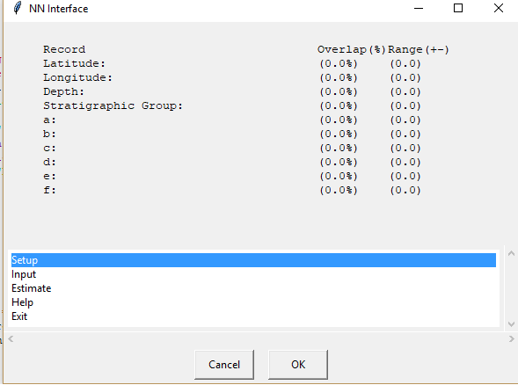
Start
User guide
Run gui_main.py
Make sure network10.json, and the other python files are in the same dir.

Slide 15
Step by step guide
Run gui_main.py
Click Setup + OK
Click Input + OK
Input variables
Use period for decimals
Use CAPS for Stratigraphic groups
Click Estimate + OK

Slide 16
Options
Setup: Loads network and prepares encoder
Input: Enables manual input of variables
Estimate: Runs given variables through network and returns estimates
Help: Displays info about data input
Exit: Exits the GUI and program

Slide 17
Other
Overlap The % match between the value and the network column representing it
Range The range of values suggested by the network

Slide 18
Note:
Setup must be run at the beginning of a session
Decimals are written with a period
Stratigraphic groups are written in all CAPS

Slide 19
Theory

Slide 20
Overview
Input
Record
Network
Estimate
Steps
Extract and parse data
Encode data
Create network
Train network
Estimate values

Slide 21
1) Extract and parse
Loads data from csv files
Place data in list
Join data together, parse and pad
Input = [well_id, name, latitude, longitude, plug_id, depth, strat-group, a, b, c, d, e, f]

Slide 22
2) Encode data
Variable = 12
Variable = [0,1,1,0]
Record = [0,1,1,0,0,0,0,0,
0,1,1,1,0,0,1,1,0,0,
0,1,1,0,0,0,0,1,1,1]
For each variable in input:
Encode the value and represent as list of 1’s and 0’s
Join together encoded variables to form a record

Slide 23
3) Setup Network
Column =
[0.3,0.6,0.7,0.9,0.5,0.3,0.1,0.8,0.3,0.5,…
Network = [[], [], [], [], [], [], [], [], [], [], [], [], [], [], [], [], [], [], [], [], []]
Create a list of lists
Each nested list (column) is as long as a “record”
Fill nested list with random values between 0-1

Slide 24
4) Train network
For each list in network (column):
Compare value in column with a threshold value and turn into 0 or 1
Compare column to record
If enough bits are the same they are considered a match and the values in the column are increased or decreased
Column = [0.3,0.6,0.7,0.9,0.5,0.3,0.1,0.8,0.3,0.5..
Threshold = 0.6
Column = [0 ,1 ,1 ,1 ,0 ,0 ,0 ,1 ,0 ,0 …
Record = [0 ,0 ,1 ,1 ,1 ,0 ,0 ,0 ,0 ,0 …
Column = [0.2,0.5,0.8,0.9,0.6,0.2,0.1,0.7,0.2,0.4..

Slide 25
5) Estimate Values
Create a record from the variables provided as input
Find the column with the best match
Extract the segment encoding the variable being estimated
Convert extract to value
Record = [1,1,0,0,0,1,1,0,0,0,0,0,1,1,0,]
Column = [0,1,1,0,0,1,0,0,1,1,0,0,1,1,1,]
Extract = [0,1,1,0]
Value = 12

Slide 26
Discussion

Slide 27
Network
Encoder
Learning
Front end GUI

Slide 28
Network
The choice to go for a spatial network was made to mirror the spatial nature of the data. Due to a lack of computing power and time, other network types could not be tested and evaluated against the spatial type chosen.

Slide 29
Learning
The learning algorithm used resulted in an average learning cycle of 20 min. This could be improved by using bitwise operations and would result in a faster more precise network.

Slide 30
Encoder
A basic encoder was chosen to represent the variables. In this case each variable was given the same amount of significance and resolution. These factors affects the accuracy of the values estimated by the network and dictates how the network weighs the variables against each other.
Resolution = 93
input =
floor( resolution*(value-minValue) / (maxValue-minValue )

Slide 31
Front end GUI
The basic nature of the GUI works well as a placeholder and prof of concept.

Slide 32
Future changes

Slide 33
Future changes
Bitwise operations in learning
Testing and comparison of different network types and architectures
Specialized encoder to more accurately represent variables
Tweaking constants such as learning increment and network size to better suit the data
Extra functions such as trending and graphing

Slide 34
Conclusion

Slide 35
Conclusion
The Network and GUI works well as a basic proof of concept. It showcases how an AI powered front end would work and hints at the possibilities it provides. Time constraints due to a summer job resulted in fewer functions for the prototype. Further development would result in an increase in speed, precision and accuracy, by tuning the network properties to match data and problem.

Slide 36
Dependencies
Python 3.6 -32bit
Numpy
EasyGui

